Slide 1
WELCOME
TO OUR
PRESENTATION
System had been designed with team includes 3 members(1 leader & 2 partners):
Nguyen Trung Thinh © (SE140344)
Le Duc Minh Thien (SE140995)
Nguyen Duc Huy (SE140422)
CLASS: SE1425

Slide 2
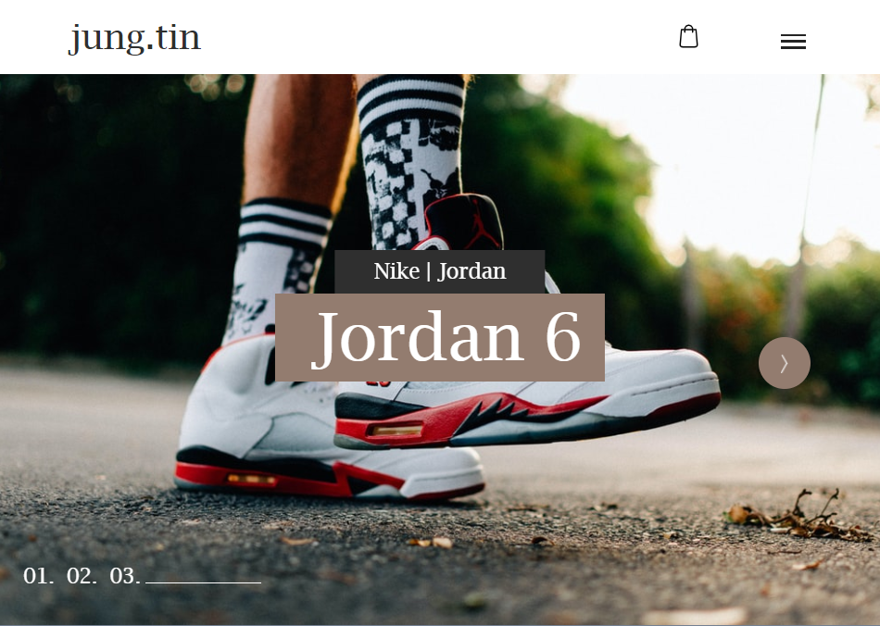
Detail Specification Jungtin Shoes Shop – version 2020
Table of Contents:
Case study
Database design
System design
Demo

Slide 3
1. Case Study
This is a web application intended for small shoes shops. The system is designed for simple customer target, with functions such as product management, order management for managers, admin.
And in addition, the customer-friendly interface allows research, viewing, surfing to find out information about the product hence promote purchases

Slide 4
System includes 3 actor: Admin, manager, customer
The features offered in the system:
Login / Register (for manager)
Manage Account (CRUD)
Manage Product (CRUD)
Shopping Cart (Add Item, Remove Item, View Cart)
Manage Invoice

Slide 5
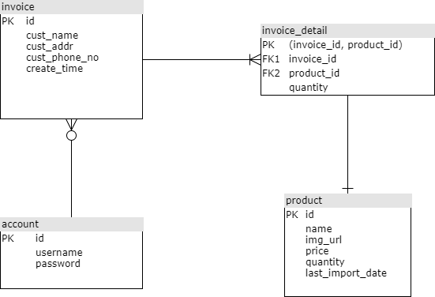
2.Database Design

Slide 6
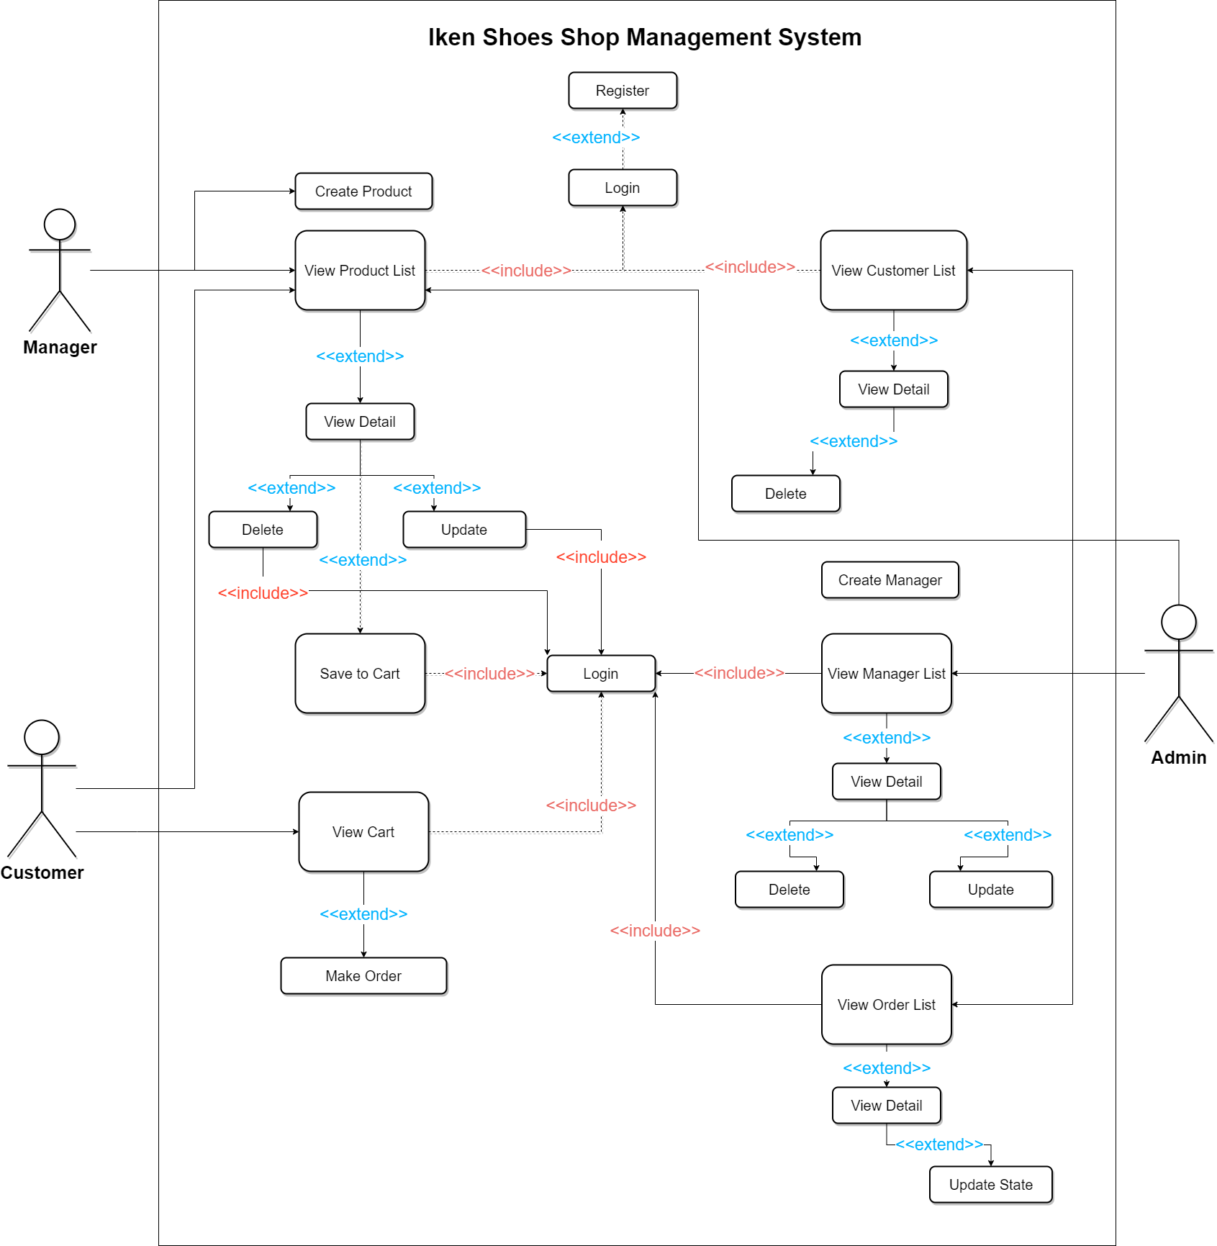
3.System Design: - Use case diagram

Slide 7
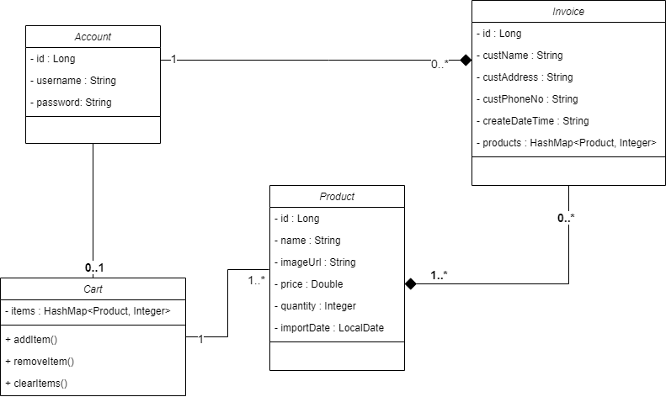
- Class Diagram

Slide 8
Demo

Slide 9
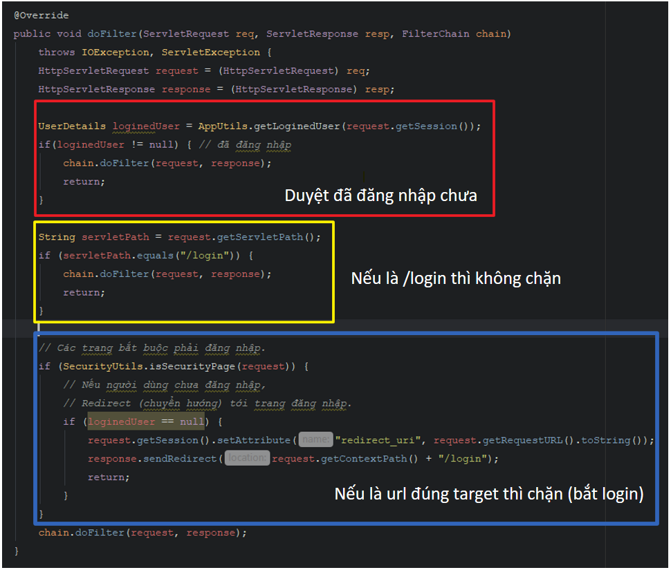

Slide 10
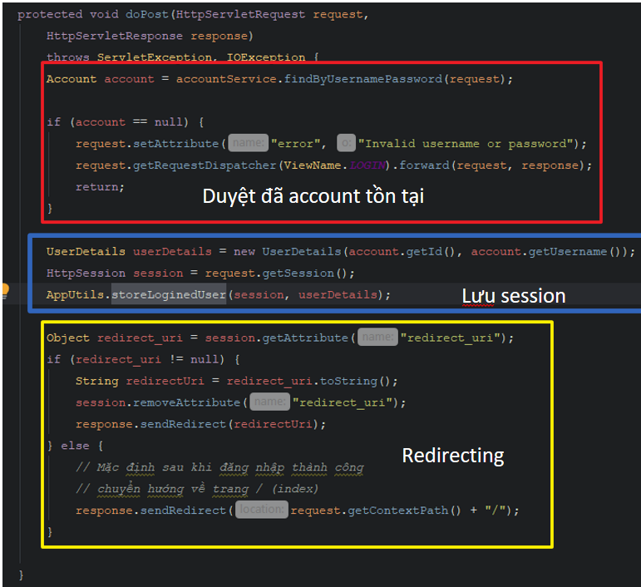

Slide 11
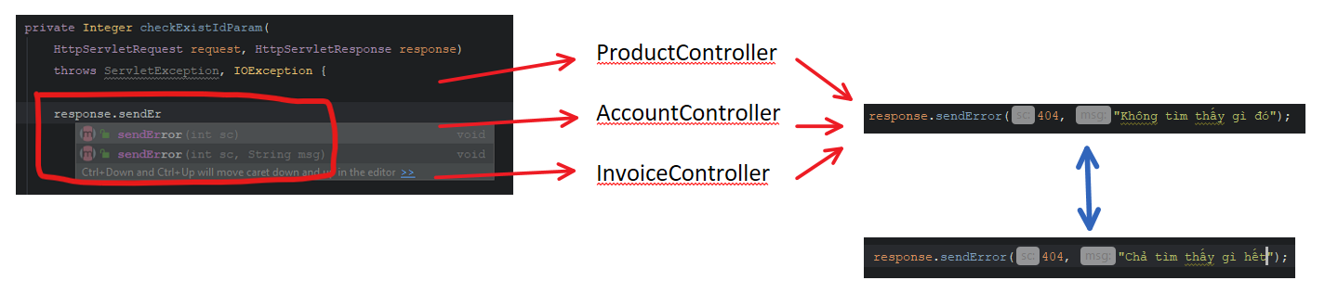

Slide 12
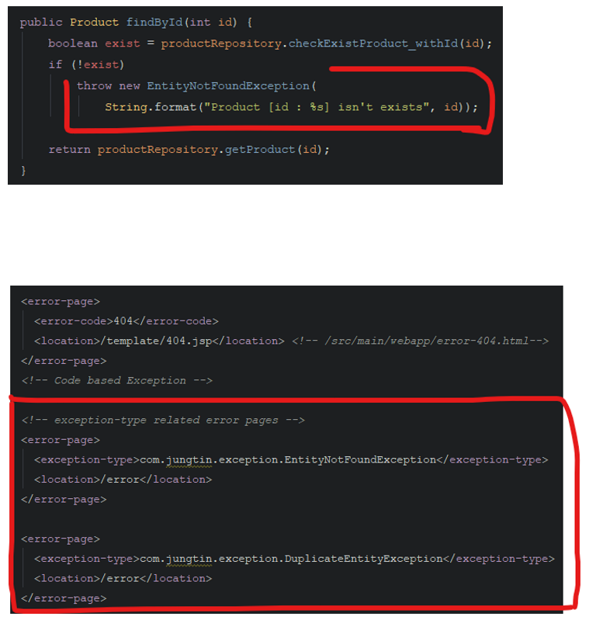
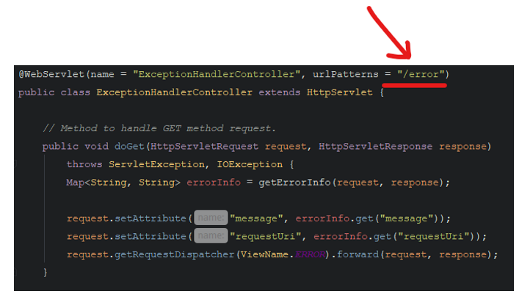

Slide 13
THANK
FOR YOUR
LISTENING!!

Slide 14
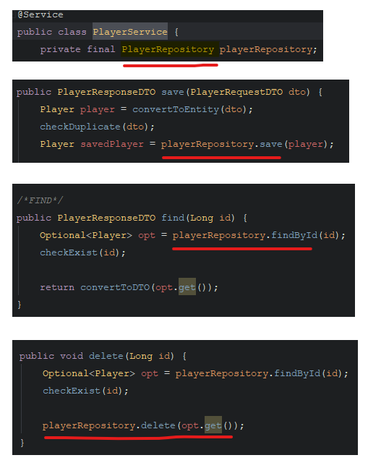

Slide 15
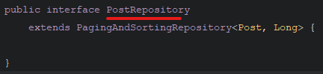

Slide 16
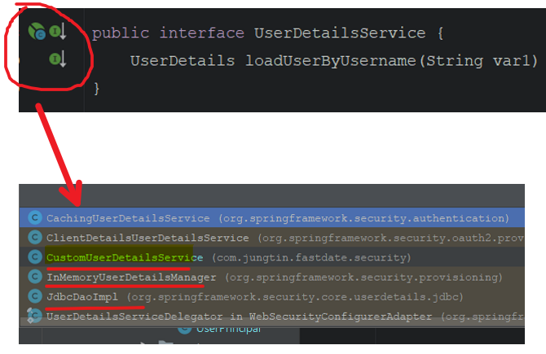
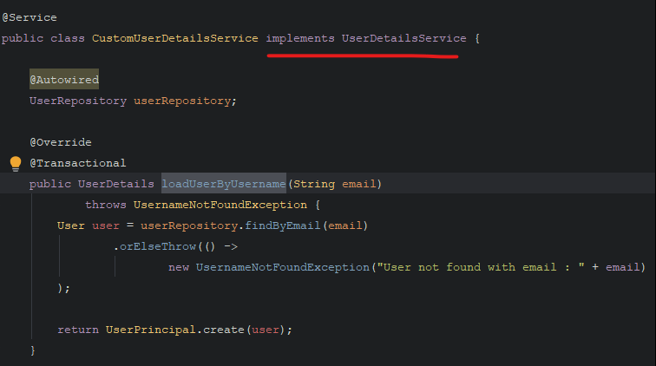
DI

